Slide 1

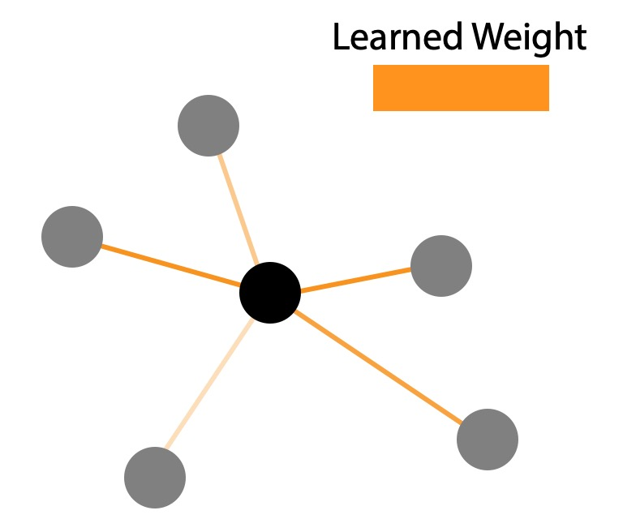
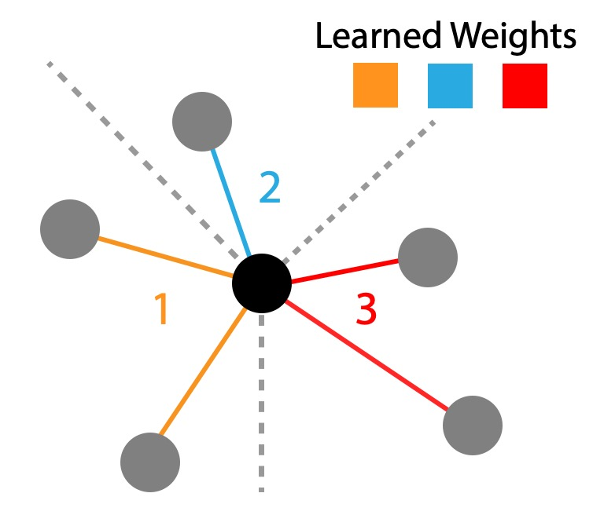
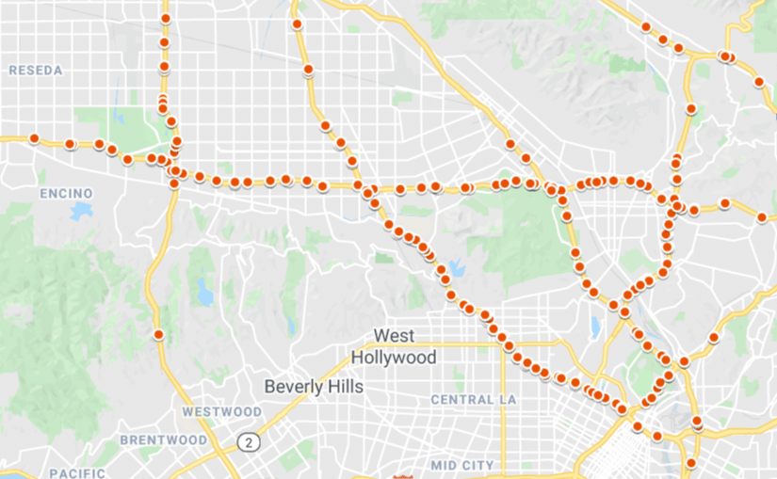
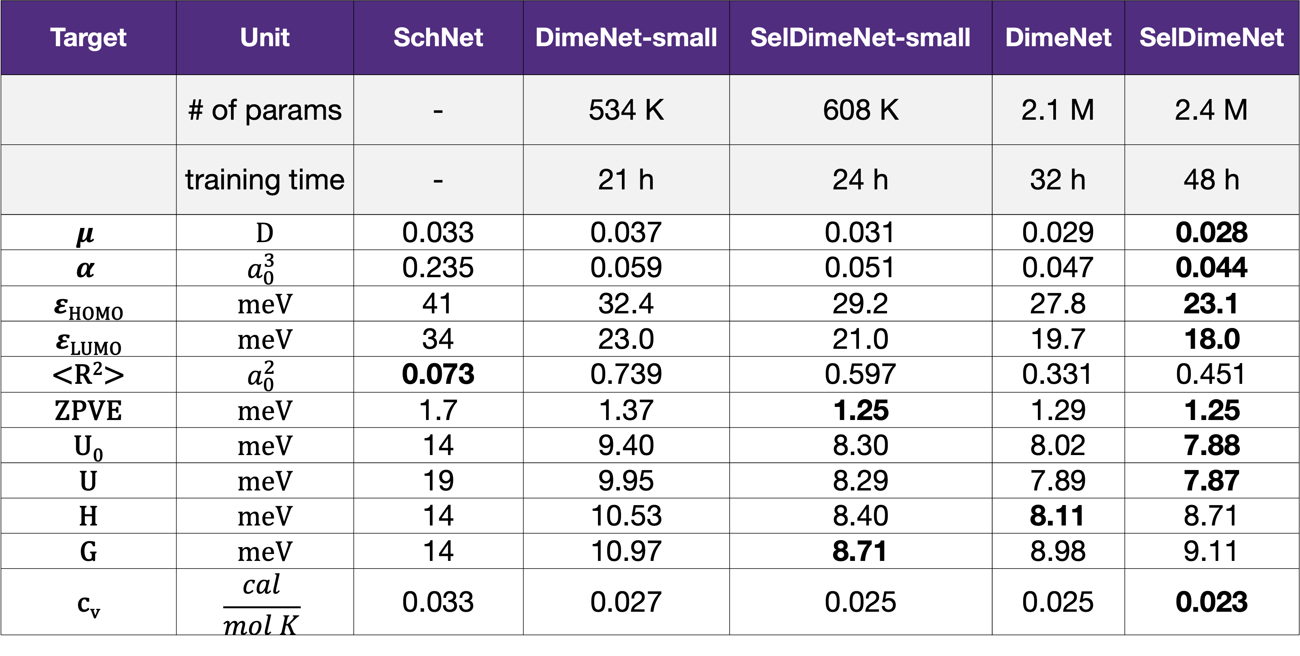
Improving Graph Networks through Selection-based Convolution
David Hart
East Carolina University
Bryan Morse
Brigham Young University
Motivation
Example 1: Spatial Classification
Is there a way to preserve intrinsic relationships between nodes in a graph network to increase performance?
We experimented on the MNIST Superpixel dataset, which represents MNIST images as a graph of nodes. We applied a directional selection function that partitioned edges based on the approximate cardinal or ordinal direction it lies in relative to the source node.
Method
Standard graph convolutions multiply neighbors by the same weight and then aggregates them together with a permutation-invariant function. The convolution may have fixed or learned edge weights, but these generally are between 0 and 1 and simply determine the amount of influence a node has during the aggregation. Intrinsic relations are lost and must be included as node features that are learned during training.
We found that selection-based networks performed better than their standard GCN counterparts. They also had faster convergence during training.
We also experimented with the COMA dataset on the task of facial expression recognition. We used a 3D directional selection function for the mesh data.
Standard GCN
In comparison, selection-based graph convolution partitions the edges into groups called selections during a preprocessing step. This allows neighbors to be multiplied by unique weights based on the assigned selections. The edge weights are learned for each selection, can be positive or negative, and can be different for each channel. This allows for the intrinsic relationship information to be preserved in the structure of the convolution. This leads to faster convergence and better performance.
On this data, selection-based networks greatly increased the performance of standard networks, outperformed GAT and approached the accuracy of approaches specifically designed for 3D data.
Network | F1 Score
GCN (Kipf et al.) | 0.282
SelGCN | 0.770
SAGEConv (Hamilton et al.) | 0.150
SelSAGEConv | 0.742
GAT (Velickovic et al.) | 0.600
EdgeConv (Wang et al.) | 0.860
Selection-based GCN
Example 2: Traffic Prediction
Example 3: Molecular Property Prediction
We experimented on the METR-LA dataset, which contains traffic data for highways in Los Angeles County. Traffic speed is measured across 207 sensors averaged over 5-minute increments at various times during the day.
We used a standard temporal backbone, then modified the spatial aggregator to include selection. A distance-based selection function was used to capture the effects of spatial proximity to traffic buildup.
We experimented on the QM9 dataset, which contains over 130,000 organic molecule descriptions. The task is to predict quantum properties such as Atomization Energy.
We modified DimeNet, a state-of-the-art graph network designed for molecular data. We designed a selection function that operates on angles between triplets of atoms.
The selection-based DimeNet decreases the error in prediction for many of the QM9 tasks. Additionally, we found a much smaller version of DimeNet with selection added could perform similarly to the original network.
Target | Unit | SchNet | DimeNet-small | SelDimeNet-small | DimeNet | SelDimeNet
 | # of params | - | 534 K | 608 K | 2.1 M | 2.4 M
 | training time | - | 21 h | 24 h | 32 h | 48 h
$$μ$$ | D | 0.033 | 0.037 | 0.031 | 0.029 | 0.028
$$α$$ | $$a_{0}^{3}$$ | 0.235 | 0.059 | 0.051 | 0.047 | 0.044
$ε$_{HOMO} | meV | 41 | 32.4 | 29.2 | 27.8 | 23.1
$ε$_{LUMO} | meV | 34 | 23.0 | 21.0 | 19.7 | 18.0
<R²> | $$a_{0}^{2}$$ | 0.073 | 0.739 | 0.597 | 0.331 | 0.451
ZPVE | meV | 1.7 | 1.37 | 1.25 | 1.29 | 1.25
U₀ | meV | 14 | 9.40 | 8.30 | 8.02 | 7.88
U | meV | 19 | 9.95 | 8.29 | 7.89 | 7.87
H | meV | 14 | 10.53 | 8.40 | 8.11 | 8.71
G | meV | 14 | 10.97 | 8.71 | 8.98 | 9.11
c_{v} | $$\frac{cal}{mol K}$$ | 0.033 | 0.027 | 0.025 | 0.025 | 0.023
Network | Layers | # Params | 15 Min | 30 Min | 60 Min
GCNConv | 1 | 26.1K | 6.186 | 6.356 | 6.654
GCNConv (EW) | 1 | 26.1K | 5.265 | 5.591 | 6.100
GAT | 1 | 78.7K | 3.206 | 3.788 | 4.632
SelGCNConv | 1 | 75.3K | 3.010 | 3.603 | 4.472
GCNConv | 2 | 38.6K | 6.366 | 6.479 | 6.674
GCNConv (EW) | 2 | 38.6K | 5.837 | 6.021 | 6.326
GAT | 2 | 277K | 3.332 | 3.860 | 4.670
SelGCNConv | 2 | 136K | 2.901 | 3.389 | 4.073
GCNConv | 3 | 51.1K | 6.225 | 6.331 | 6.521
GCNConv (EW) | 3 | 51.1K | 5.993 | 6.140 | 6.389
GAT | 3 | 476K | 3.272 | 3.780 | 4.512
SelGCNConv | 3 | 198K | 2.814 | 3.212 | 3.707
Selection-based network greatly decreases the average error on the traffic prediction task. It outperforms other spatial aggregators and improves in performance with a deeper network. This is because it has a nonlinear function over distance unlike other aggregators.
We also found our network’s performance to be similar to state-of-the-art approaches.

